Slide 1

CIS 133DA FINAL PROJECT PROPOSAL
WEBSITE NAME:
SONORAN DESERT CLUB
@ SCC
Notes:
Title Page
- Sonoran Desert Club Website

Slide 2

SONORAN DESERT CLUB @ SCC
PURPOSE OF THE WEBSITE:
To promote the Sonoran Desert Club activities, gain more members, and share updated information with current members.
Notes:
Purpose of website

Slide 3
SITE MAP
HOMEPAGE
ABOUT US
WHAT WE DO
CONNECT
GET INVOLVED
CLUB ACTIVITIES
AT TOAD HALL
Notes:
Site map

Slide 4
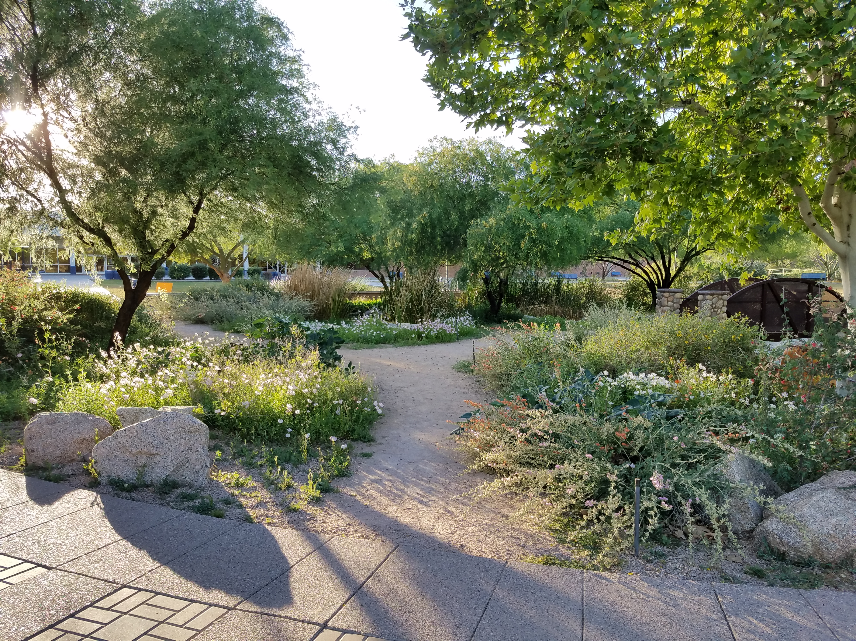
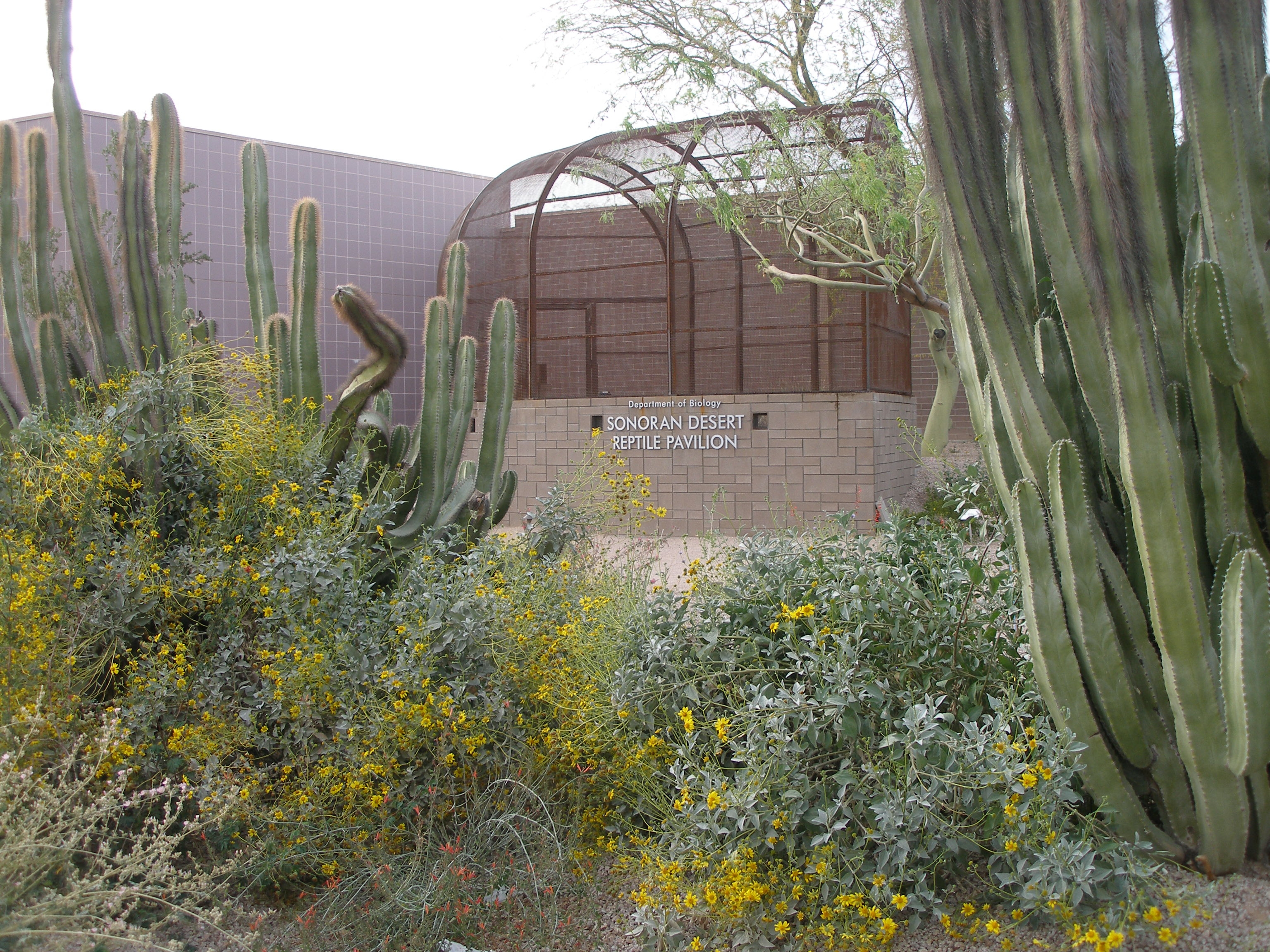






WEBSITE WIREFRAME: ABOUT US PAGE
SONORAN DESERT CLUB
ABOUT US
WHAT WE DO
CONNECT
GET INVOLVED
AT SCOTTSDALE COMMUNITY COLLEGE
Learn and preserve
the wildlife of Arizona on campus
Explore and discover interesting plants and animals native to Arizona from all around the state, while being able to learn from and connect with professionals, enthusiasts, as well as like-minded learners through different projects and activities, all at Scottsdale Community College.
What is the Sonoran Desert Club?
A place that welcomes all talent, where students can partake in different projects and activities based on their skills and preferences that will help educate and promote the flowering fauna.
An organization under the Center for Nature and Urban Wildlife Department that provides students of any program the opportunity to understand, appreciate, and share their passion of the wildlife, ecology, and biodiversity of the Sonoran Desert to others.
CONNECT
GET INVOLVED
Sonoran Desert Club @ SCC
9000 E Chaparral Rd, Scottsdale, AZ 85256
Notes:
Website pages

Slide 5
WEBSITE WIREFRAME: ABOUT US PAGE
SONORAN DESERT CLUB
ABOUT US
WHAT WE DO
CONNECT
GET INVOLVED
AT SCOTTSDALE COMMUNITY COLLEGE
Learn and preserve
the wildlife of Arizona on campus
Explore and discover interesting plants and animals native to Arizona from all around the state, while being able to learn from and connect with professionals, enthusiasts, as well as like-minded learners through different projects and activities, all at Scottsdale Community College.
What is the Sonoran Desert Club?
A place that welcomes all talent, where students can partake in different projects and activities based on their skills and preferences that will help educate and promote the flowering fauna.
An organization under the Center for Nature and Urban Wildlife Department that provides students of any program the opportunity to understand, appreciate, and share their passion of the wildlife, ecology, and biodiversity of the Sonoran Desert to others.
CONNECT
GET INVOLVED
Sonoran Desert Club @ SCC
9000 E Chaparral Rd, Scottsdale, AZ 85256
Notes:
Website pages

Slide 6




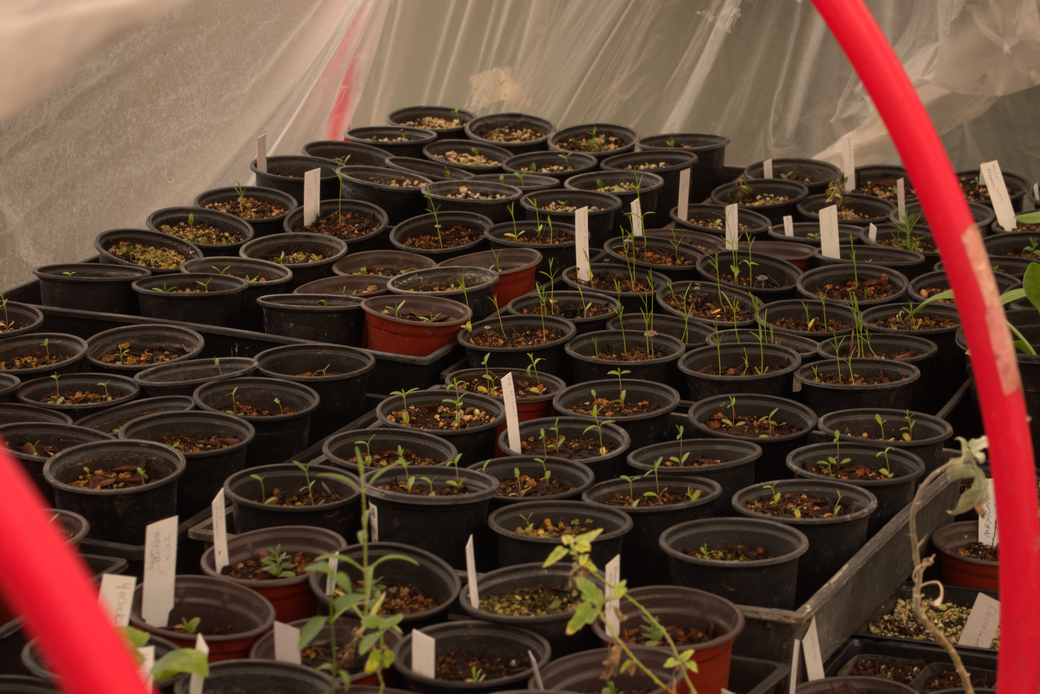
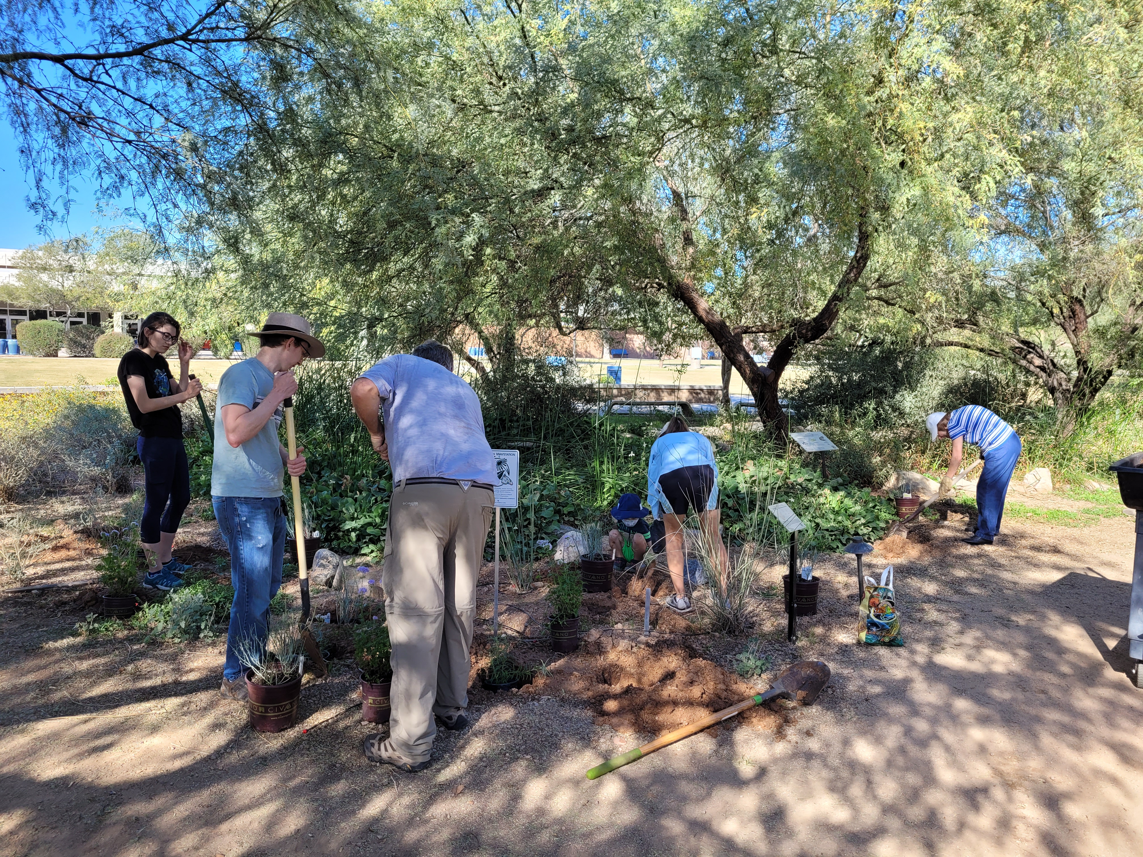
WEBSITE WIREFRAME: WHAT WE DO – CLUB ACTIVITIES PAGE
SONORAN DESERT CLUB
ABOUT US
WHAT WE DO
CONNECT
GET INVOLVED
AT SCOTTSDALE COMMUNITY COLLEGE
CLUB ACTIVITIES
AT TOAD HALL
Club Activities
With support from the Center for Nature and Urban Wildlife, the Sonoran Desert Club has been able to involve themselves in:
Community Projects
Preservation
Restoration
Conservation
Past Activities
CNUW Plant Sale
Club members were able to help CNUW and learn how to grow and cultivate native plants throughout the semester, and help people learn and pick the right plants during the sale.
Monarch Waystation Planting
Sonoran Desert Club members participated in adding host plants like milkweed to provide a habitat on campus for the endangered monarch butterflies and be able to attract and support pollinators.
Sonoran Desert Club @ SCC
9000 E Chaparral Rd, Scottsdale, AZ 85256
Notes:
Website pages

Slide 7
WEBSITE WIREFRAME: WHAT WE DO – CLUB ACTIVITIES PAGE
SONORAN DESERT CLUB
ABOUT US
WHAT WE DO
CONNECT
GET INVOLVED
AT SCOTTSDALE COMMUNITY COLLEGE
CLUB ACTIVITIES
AT TOAD HALL
Club Activities
With support from the Center for Nature and Urban Wildlife, the Sonoran Desert Club has been able to involve themselves in:
Community Projects
Preservation
Restoration
Conservation
Past Activities
CNUW Plant Sale
Club members were able to help CNUW and learn how to grow and cultivate native plants throughout the semester, and help people learn and pick the right plants during the sale.
Monarch Waystation Planting
Sonoran Desert Club members participated in adding host plants like milkweed to provide a habitat on campus for the endangered monarch butterflies and be able to attract and support pollinators.
Sonoran Desert Club @ SCC
9000 E Chaparral Rd, Scottsdale, AZ 85256
Notes:
Website pages

Slide 8
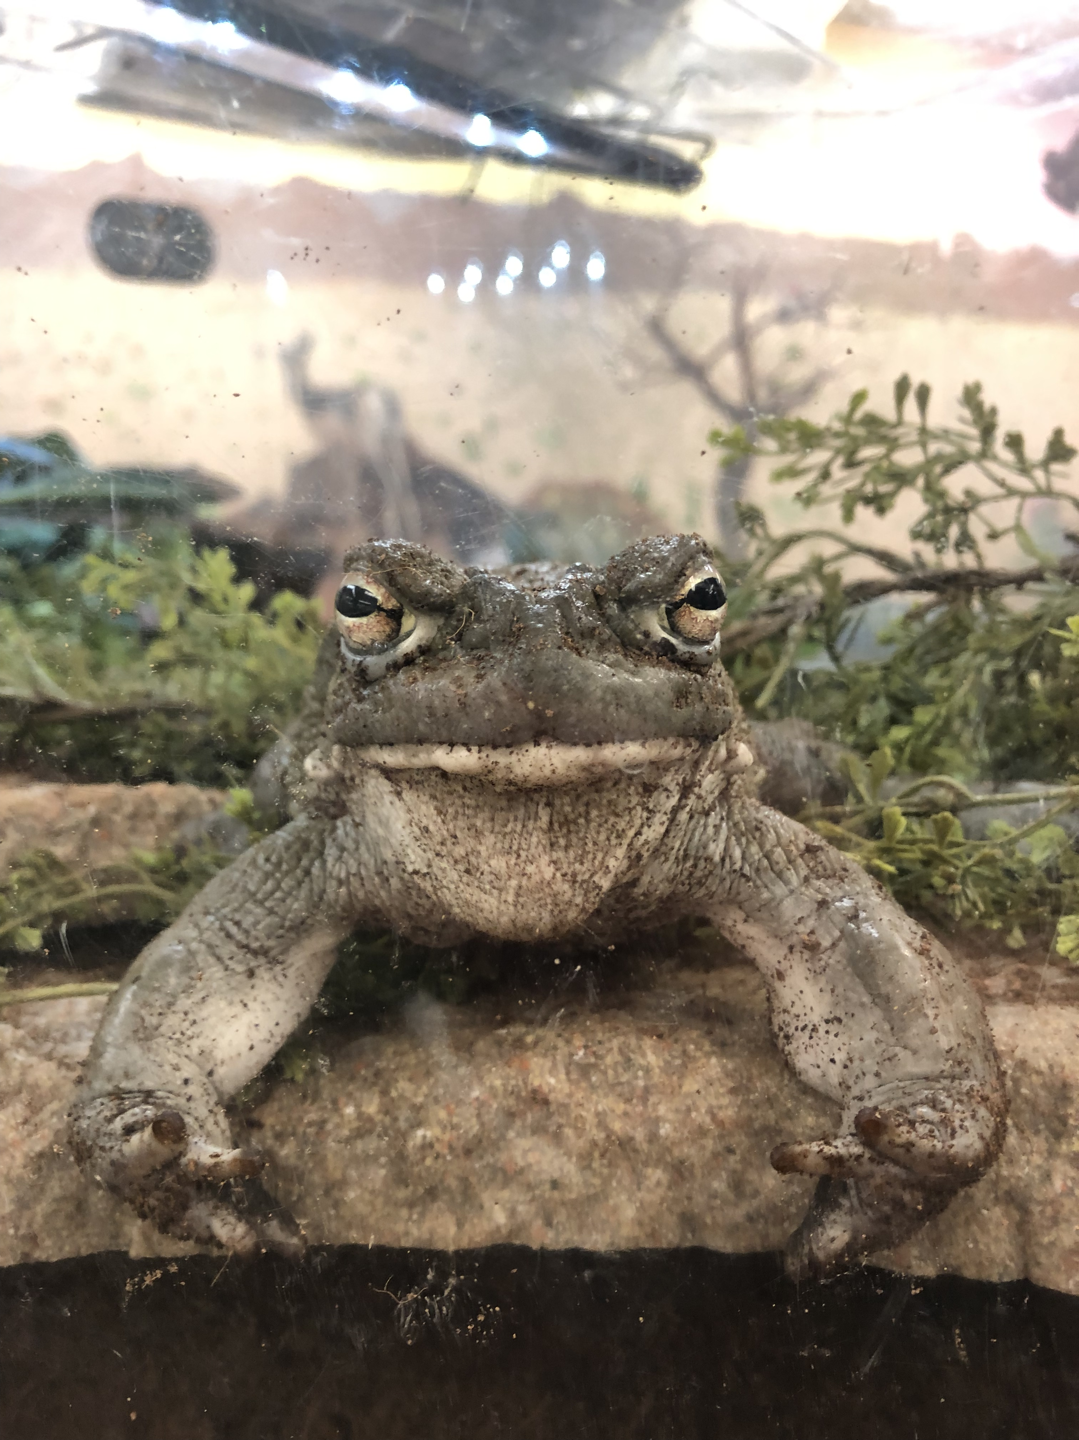


WEBSITE WIREFRAME: WHAT WE DO – AT TOAD HALL PAGE
SONORAN DESERT CLUB
ABOUT US
WHAT WE DO
CONNECT
GET INVOLVED
AT SCOTTSDALE COMMUNITY COLLEGE
Sonoran Desert Club at Toad Hall
One of CNUW’s six exhibits, Toad Hall is home to a collection of different native wildlife species including Gila Monsters, Desert Tortoises, Toads, Snakes, and many more.
With partnerships with CNUW, Sonoran Desert Club members have the opportunity to share their passion with wildlife, especially animals, to fellow students and community members of all ages by creating interactive table stations during Open House days.
Table Station Types
 | Animal Showcase | Interactive Mini Games | Species Discussions
Description | Be able to bring out one of Toad Hall’s non-toxic animal residents to help people get to know them more and up close. | Have visitors interact and play a type of mini game where they are able to learn interesting facts about the wildlife. | Talk about and introduce a biodiversity topic you are passionate about that is not present in Toad Hall.
Table Activities | Let people touch and interact with the animal. Tell interesting facts about the species. Tell interesting stories of what the animal does on normal days at CNUW | Guessing game activities to foster analytical thinking for a deeper understanding of wildlife. Games that focus on the mundane aspects of life to allow visitors to relate and grasp the topic more. | Present visual graphics, samples, or anything relevant to help people visualize your topic. Make interesting discussions that explain why your topic is interesting and important.
Interested in presenting?
SIGN UP
Sonoran Desert Club @ SCC
9000 E Chaparral Rd, Scottsdale, AZ 85256
Notes:
Website pages

Slide 9
WEBSITE WIREFRAME: WHAT WE DO – AT TOAD HALL PAGE
SONORAN DESERT CLUB
ABOUT US
WHAT WE DO
CONNECT
GET INVOLVED
AT SCOTTSDALE COMMUNITY COLLEGE
Sonoran Desert Club at Toad Hall
One of CNUW’s six exhibits, Toad Hall is home to a collection of different native wildlife species including Gila Monsters, Desert Tortoises, Toads, Snakes, and many more.
With partnerships with CNUW, Sonoran Desert Club members have the opportunity to share their passion with wildlife, especially animals, to fellow students and community members of all ages by creating interactive table stations during Open House days.
Table Station Types
 | Animal Showcase | Interactive Mini Games | Species Discussions
Description | Be able to bring out one of Toad Hall’s non-toxic animal residents to help people get to know them more and up close. | Have visitors interact and play a type of mini game where they are able to learn interesting facts about the wildlife. | Talk about and introduce a biodiversity topic you are passionate about that is not present in Toad Hall.
Table Activities | Let people touch and interact with the animal. Tell interesting facts about the species. Tell interesting stories of what the animal does on normal days at CNUW | Guessing game activities to foster analytical thinking for a deeper understanding of wildlife. Games that focus on the mundane aspects of life to allow visitors to relate and grasp the topic more. | Present visual graphics, samples, or anything relevant to help people visualize your topic. Make interesting discussions that explain why your topic is interesting and important.
Interested in presenting?
SIGN UP
Sonoran Desert Club @ SCC
9000 E Chaparral Rd, Scottsdale, AZ 85256
Notes:
Website pages

Slide 10
WEBSITE WIREFRAME: WHAT WE DO – AT TOAD HALL PAGE
SONORAN DESERT CLUB
ABOUT US
WHAT WE DO
CONNECT
GET INVOLVED
AT SCOTTSDALE COMMUNITY COLLEGE
Sonoran Desert Club at Toad Hall
One of CNUW’s six exhibits, Toad Hall is home to a collection of different native wildlife species including Gila Monsters, Desert Tortoises, Toads, Snakes, and many more.
With partnerships with CNUW, Sonoran Desert Club members have the opportunity to share their passion with wildlife, especially animals, to fellow students and community members of all ages by creating interactive table stations during Open House days.
Table Station Types
 | Animal Showcase | Interactive Mini Games | Species Discussions
Description | Be able to bring out one of Toad Hall’s non-toxic animal residents to help people get to know them more and up close. | Have visitors interact and play a type of mini game where they are able to learn interesting facts about the wildlife. | Talk about and introduce a biodiversity topic you are passionate about that is not present in Toad Hall.
Table Activities | Let people touch and interact with the animal. Tell interesting facts about the species. Tell interesting stories of what the animal does on normal days at CNUW | Guessing game activities to foster analytical thinking for a deeper understanding of wildlife. Games that focus on the mundane aspects of life to allow visitors to relate and grasp the topic more. | Present visual graphics, samples, or anything relevant to help people visualize your topic. Make interesting discussions that explain why your topic is interesting and important.
Interested in presenting?
SIGN UP
Sonoran Desert Club @ SCC
9000 E Chaparral Rd, Scottsdale, AZ 85256
Notes:
Website pages

Slide 11
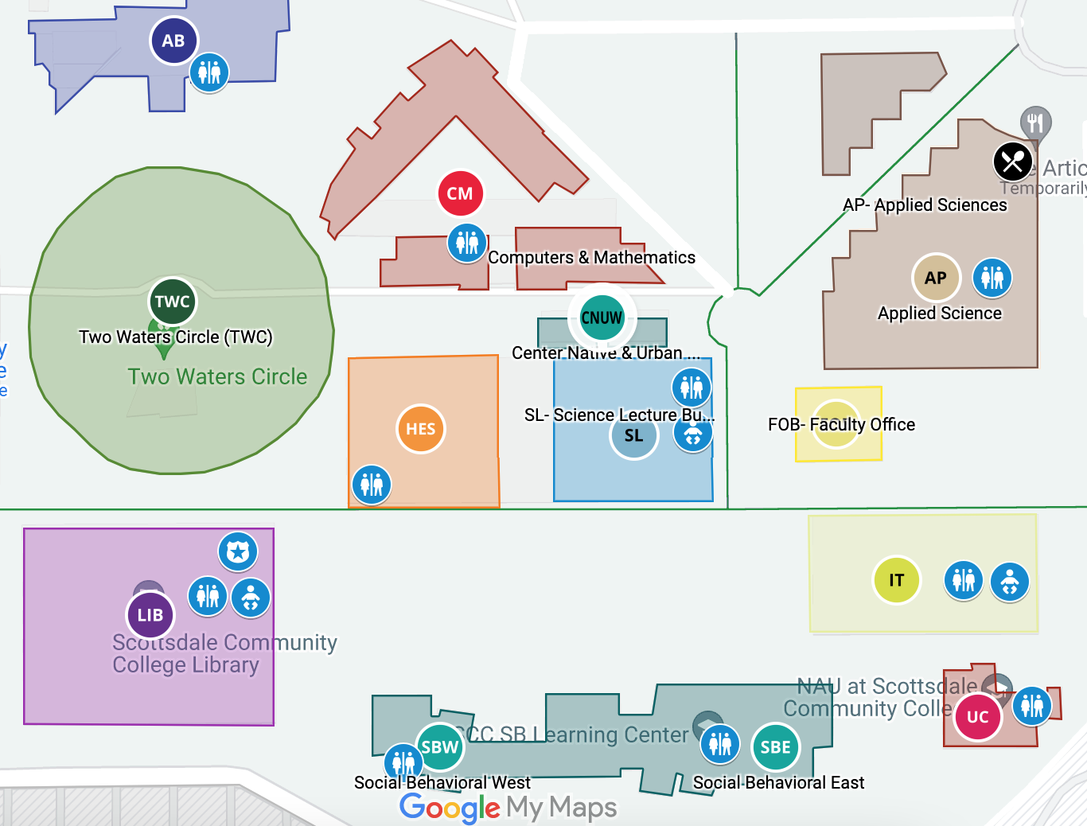
WEBSITE WIREFRAME: CONNECT PAGE
SONORAN DESERT CLUB
ABOUT US
WHAT WE DO
CONNECT
GET INVOLVED
AT SCOTTSDALE COMMUNITY COLLEGE
Club Meeting Details
Contact Person
When: Every other Monday and Thursday
Time: 2:00pm to 3:00pm
Location:
Hall of Biodiversity Past,
Center for Nature and Urban Wildlife Building,
Scottsdale Community College
9000 E Chaparral Rd, Scottsdale, AZ 85256
Any questions? Ask the club advisor!
Natalie Case
Club Advisor, Education Programs Developer at CNUW
(480) 423-6737
natalie.case@scottsdalecc.edu
Social Media
Follow CNUW on social media to get the latest news about the club and interact with fellow members.
Instagram: @cnuw_cnuw
Discord Server: Center for Nature and Urban Wildlife
Sonoran Desert Club @ SCC
9000 E Chaparral Rd, Scottsdale, AZ 85256
Notes:
Website pages

Slide 12
WEBSITE WIREFRAME: CONNECT PAGE
SONORAN DESERT CLUB
ABOUT US
WHAT WE DO
CONNECT
GET INVOLVED
AT SCOTTSDALE COMMUNITY COLLEGE
Club Meeting Details
Contact Person
When: Every other Monday and Thursday
Time: 2:00pm to 3:00pm
Location:
Hall of Biodiversity Past,
Center for Nature and Urban Wildlife Building,
Scottsdale Community College
9000 E Chaparral Rd, Scottsdale, AZ 85256
Any questions? Ask the club advisor!
Natalie Case
Club Advisor, Education Programs Developer at CNUW
(480) 423-6737
natalie.case@scottsdalecc.edu
Social Media
Follow CNUW on social media to get the latest news about the club and interact with fellow members.
Instagram: @cnuw_cnuw
Discord Server: Center for Nature and Urban Wildlife
Sonoran Desert Club @ SCC
9000 E Chaparral Rd, Scottsdale, AZ 85256
Notes:
Website pages

Slide 13



WEBSITE WIREFRAME: GET INVOLVED PAGE
SONORAN DESERT CLUB
ABOUT US
WHAT WE DO
CONNECT
GET INVOLVED
AT SCOTTSDALE COMMUNITY COLLEGE
Interested? Come and Join Us!
Become a Sonoran Desert Club Member
Present About Wildlife at Toad Hall
Full Name
First Name
Last Name
Age
MEID
Phone Number
Email Address
School or personal email
I agree to periodically receive club updates, events and announcements through the email I provided. *
Semester
Meeting days I can attend
Select Semester
Select Days
Activities I would like to participate in:
Plant care, restoration, and conservation
Research projects and educating people about wildlife
Animal care and conservation
Arts and crafts
Other Activity Suggestions
Submit
Sonoran Desert Club @ SCC
9000 E Chaparral Rd, Scottsdale, AZ 85256
Notes:
Website pages

Slide 14
WEBSITE WIREFRAME: GET INVOLVED PAGE
SONORAN DESERT CLUB
ABOUT US
WHAT WE DO
CONNECT
GET INVOLVED
AT SCOTTSDALE COMMUNITY COLLEGE
Interested? Come and Join Us!
Become a Sonoran Desert Club Member
Present About Wildlife at Toad Hall
Full Name
First Name
Last Name
Age
MEID
Phone Number
Email Address
School or personal email
I agree to periodically receive club updates, events and announcements through the email I provided. *
Semester
Meeting days I can attend
Select Semester
Select Days
Activities I would like to participate in:
Plant care, restoration, and conservation
Research projects and educating people about wildlife
Animal care and conservation
Arts and crafts
Other Activity Suggestions
Submit
Sonoran Desert Club @ SCC
9000 E Chaparral Rd, Scottsdale, AZ 85256
Notes:
Website pages

Slide 15


WEBSITE WIREFRAME: GET INVOLVED PAGE
SONORAN DESERT CLUB
ABOUT US
WHAT WE DO
CONNECT
GET INVOLVED
AT SCOTTSDALE COMMUNITY COLLEGE
Interested? Come and Join Us!
Become a Sonoran Desert Club Member
Present About Wildlife at Toad Hall
Full Name
First Name
Last Name
MEID
Phone Number
Email Address
School or personal email
Presentation Details
Date
Type
MM/DD/YYYY
Select Type
Topic
Description
Submit
Sonoran Desert Club @ SCC
9000 E Chaparral Rd, Scottsdale, AZ 85256
Notes:
Website pages

Slide 16
WEBSITE WIREFRAME: GET INVOLVED PAGE
SONORAN DESERT CLUB
ABOUT US
WHAT WE DO
CONNECT
GET INVOLVED
AT SCOTTSDALE COMMUNITY COLLEGE
Interested? Come and Join Us!
Become a Sonoran Desert Club Member
Present About Wildlife at Toad Hall
Full Name
First Name
Last Name
MEID
Phone Number
Email Address
School or personal email
Presentation Details
Date
Type
MM/DD/YYYY
Select Type
Topic
Description
Submit
Sonoran Desert Club @ SCC
9000 E Chaparral Rd, Scottsdale, AZ 85256
Notes:
Website pages

Slide 17
MEDIA QUERY LAYOUT: ABOUT US PAGE
different projects and activities based on their skills and preferences that will help educate and promote the flowering fauna.
SONORAN DESERT CLUB
What is the Sonoran Desert Club?
AT SCOTTSDALE COMMUNITY COLLEGE
ABOUT US
WHAT WE DO
CONNECT
GET INVOLVED
CONNECT
GET INVOLVED
Learn and preserve
the wildlife of Arizona on campus
Sonoran Desert Club @ SCC
9000 E Chaparral Rd, Scottsdale, AZ 85256
Explore and discover interesting plants and animals native to Arizona from all around the state, while being able to learn from and connect with professionals, enthusiasts, as well as like-minded learners through different projects and activities, all at Scottsdale Community College.
An organization under the Center for Nature and Urban Wildlife Department that provides students of any program the opportunity to understand, appreciate, and share their passion of the wildlife, ecology, and biodiversity of the Sonoran Desert to others.
A place that welcomes all talent, where students can partake in different projects and activities based on their skills and preferences that will help educate and promote the flowering fauna.
Notes:
Mobile media query

Slide 18
MEDIA QUERY LAYOUT: WHAT TO DO – CLUB ACTIVITIES PAGE
Planting
SONORAN DESERT CLUB
Past Activities
Sonoran Desert Club members participated in adding host plants like milkweed to provide a habitat on campus for the endangered monarch butterflies and be able to attract and support pollinators.
AT SCOTTSDALE COMMUNITY COLLEGE
ABOUT US
WHAT WE DO
CONNECT
GET INVOLVED
Club Activities
With support from the Center for Nature and Urban Wildlife, the Sonoran Desert Club has been able to involve themselves in:
Sonoran Desert Club @ SCC
9000 E Chaparral Rd, Scottsdale, AZ 85256
CNUW Plant Sale
Club members were able to help CNUW and learn how to grow and cultivate native plants throughout the semester, and help people learn and pick the right plants during the sale.
Community Projects
Preservation
Conservation
Restoration
Monarch Waystation
Notes:
Mobile media query

Slide 19
MEDIA QUERY LAYOUT: WHAT TO DO – AT TOAD HALL PAGE
SONORAN DESERT CLUB
ABOUT US
WHAT WE DO
CONNECT
GET INVOLVED
AT SCOTTSDALE COMMUNITY COLLEGE
Interested in presenting?
SONORAN DESERT CLUB
With partnerships with CNUW, Sonoran Desert Club members have the opportunity to share their passion with wildlife, especially animals, to fellow students and community members of all ages by creating interactive table stations during Open House days.
AT SCOTTSDALE COMMUNITY COLLEGE
ABOUT US
WHAT WE DO
CONNECT
GET INVOLVED
SIGN UP
Sonoran Desert Club at Toad Hall
Table Station Types
Sonoran Desert Club @ SCC
9000 E Chaparral Rd, Scottsdale, AZ 85256
 | Animal Showcase | Interactive Mini Games | Species Discussions
Description | Be able to bring out one of Toad Hall’s non-toxic animal residents to help people get to know them more and up close. | Have visitors interact and play a type of mini game where they are able to learn interesting facts about the wildlife. | Talk about and introduce a biodiversity topic you are passionate about that is not present in Toad Hall.
Table Activities | Let people touch and interact with the animal. Tell interesting facts about the species. Tell interesting stories of what the animal does on normal days at CNUW | Guessing game activities to foster analytical thinking for a deeper understanding of wildlife. Games that focus on the mundane aspects of life to allow visitors to relate and grasp the topic more. | Present visual graphics, samples, or anything relevant to help people visualize your topic. Make interesting discussions that explain why your topic is interesting and important.
One of CNUW’s six exhibits, Toad Hall is home to a collection of different native wildlife species including Gila Monsters, Desert Tortoises, Toads, Snakes, and many more.
With partnerships with CNUW, Sonoran Desert Club members have the opportunity to share their passion with wildlife, especially animals, to fellow students and community members of all ages by creating interactive table stations during Open House days.
Sonoran Desert Club at Toad Hall
One of CNUW’s six exhibits, Toad Hall is home to a collection of different native wildlife species including Gila Monsters, Desert Tortoises, Toads, Snakes, and many more.
Table Station Types
 | Animal Showcase | Interactive Mini Games | Species Discussions
Description | Be able to bring out one of Toad Hall’s non-toxic animal residents to help people get to know them more and up close. | Have visitors interact and play a type of mini game where they are able to learn interesting facts about the wildlife. | Talk about and introduce a biodiversity topic you are passionate about that is not present in Toad Hall.
Table Activities | Let people touch and interact with the animal. Tell interesting facts about the species. Tell interesting stories of what the animal does on normal days at CNUW | Guessing game activities to foster analytical thinking for a deeper understanding of wildlife. Games that focus on the mundane aspects of life to allow visitors to relate and grasp the topic more. | Present visual graphics, samples, or anything relevant to help people visualize your topic. Make interesting discussions that explain why your topic is interesting and important.
Interested in presenting?
SIGN UP
SIGN UP
Sonoran Desert Club @ SCC
9000 E Chaparral Rd, Scottsdale, AZ 85256
Notes:
Mobile media query

Slide 20
MEDIA QUERY LAYOUT: CONNECT PAGE
SONORAN DESERT CLUB
AT SCOTTSDALE COMMUNITY COLLEGE
Contact Person
ABOUT US
WHAT WE DO
CONNECT
GET INVOLVED
Any questions? Ask the club advisor!
Natalie Case
Club Advisor, Education Programs Developer at CNUW
(480) 423-6737
natalie.case@scottsdalecc.edu
Club Meeting Details
When: Every other Monday and Thursday
Time: 2:00pm to 3:00pm
Location:
Hall of Biodiversity Past,
Center for Nature and Urban Wildlife Building,
Scottsdale Community College
9000 E Chaparral Rd, Scottsdale, AZ 85256
Social Media
Follow CNUW on social media to get the latest news about the club and interact with fellow members.
Instagram: @cnuw_cnuw
Discord Server: Center for Nature and Urban Wildlife
Sonoran Desert Club @ SCC
9000 E Chaparral Rd, Scottsdale, AZ 85256
Notes:
Mobile media query

Slide 21
MEDIA QUERY LAYOUT: GET INVOLVED PAGE
Plant care, restoration and conservation
Research projects and educating people about wildlife
SONORAN DESERT CLUB
Animal care and conservation
AT SCOTTSDALE COMMUNITY COLLEGE
Arts and crafts
ABOUT US
WHAT WE DO
CONNECT
GET INVOLVED
Other Activity Suggestions
Interested? Come and Join Us!
SUBMIT
Become a Sonoran Desert Club Member
Present About Wildlife at Toad Hall
Full Name
First Name
Last Name
Sonoran Desert Club @ SCC
9000 E Chaparral Rd, Scottsdale, AZ 85256
Age
MEID
Phone Number
Email Address
School or personal email
I agree to periodically receive club updates, events and announcements through the email I provided. *
Semester
Meeting days I can attend
Select Semester
Select Days
Activities I would like to participate in:
Notes:
Mobile media query

Slide 22
MEDIA QUERY LAYOUT: GET INVOLVED PAGE
Description
SONORAN DESERT CLUB
AT SCOTTSDALE COMMUNITY COLLEGE
ABOUT US
WHAT WE DO
CONNECT
GET INVOLVED
SUBMIT
Interested? Come and Join Us!
Become a Sonoran Desert Club Member
Present About Wildlife at Toad Hall
Full Name
First Name
Last Name
Sonoran Desert Club @ SCC
9000 E Chaparral Rd, Scottsdale, AZ 85256
MEID
Phone Number
Email Address
School or personal email
Presentation Details
Date
Type
MM/DD/YYY
Select Type
Topic
Notes:
Mobile media query

Slide 23
CIS 133DA FINAL PROJECT PROPOSAL
Notes:
Title Page
- Sonoran Desert Club Website

